Slide 1
Quality review
Data Dictionary Design

Slide 2
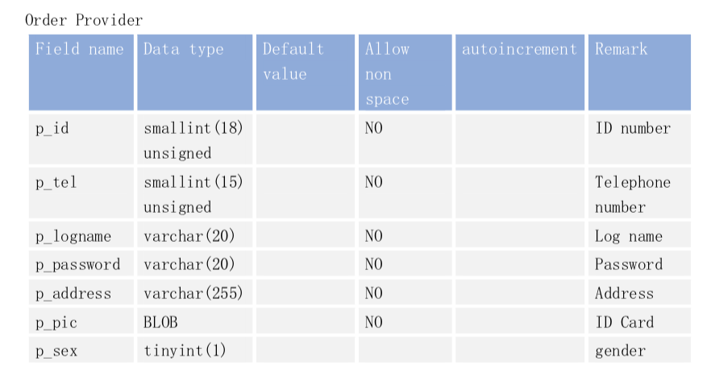
Database Dictionary

Slide 3
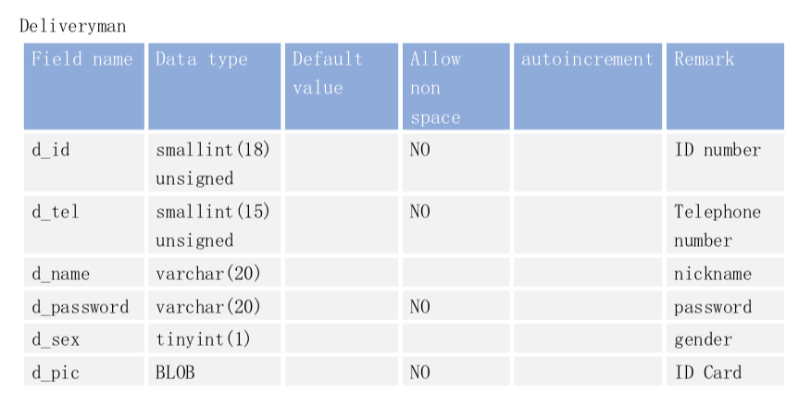

Slide 4
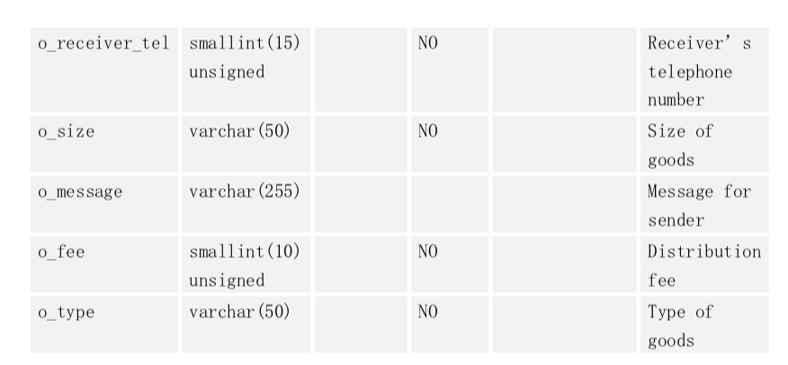

Slide 5
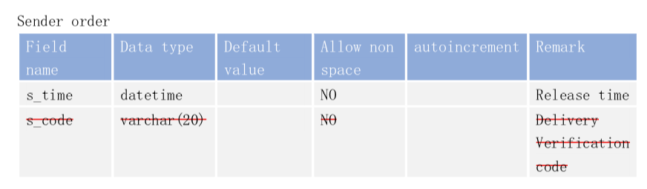

Slide 6
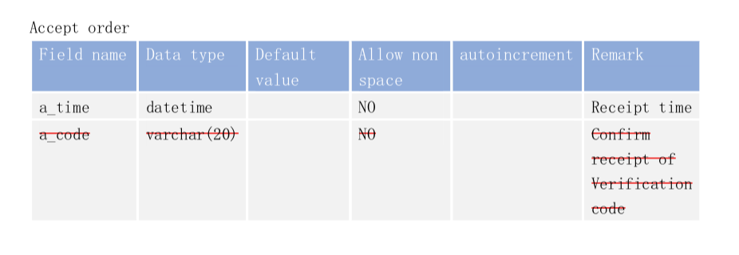

Slide 7
Thanks for your time
Database Dictionary

